Slide 1
GPS Ionospheric Error
John Clouse

Slide 2
Agenda
Ionosphere and GPS
Models and Methods
Problem statement
Dual-frequency code measurements
Code-carrier divergence
Klobuchar model
Global TEC map
Results
Conclusions
References

Slide 3
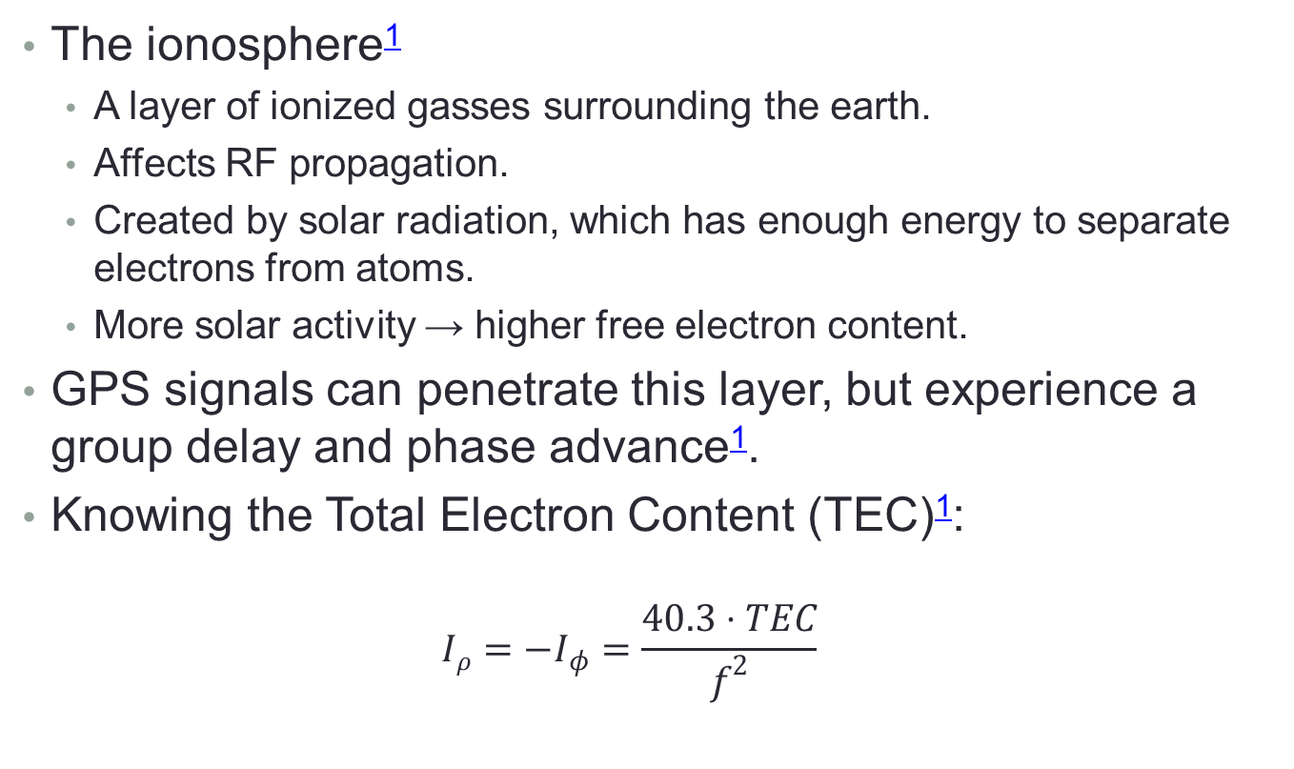
Ionosphere and GPS
The ionosphere¹
A layer of ionized gasses surrounding the earth.
Affects RF propagation.
Created by solar radiation, which has enough energy to separate electrons from atoms.
More solar activity → higher free electron content.
GPS signals can penetrate this layer, but experience a group delay and phase advance¹.
Knowing the Total Electron Content (TEC)¹:
$$Iρ=−I_{φ}=\frac{40.3⋅TEC}{f^{2}}$$

Slide 4
Problem Statement
Using multiple methods, determine the ionospheric delay at recent solar activity minimums/maximums at different latitudes.
The effects of solar activity on ionospheric delay was studied.
Solar minimum: 2009-03-20
Solar maximum: 2014-03-20
Two sites were examined.
Nanyang Technological University, Singapore (NTUS)
1.20°N, 103.40°E
Chosen for equatorial site
NIST, Boulder, CO
40.00°N, 105.26°W
Chosen for mid-latitude site

Slide 5


Dual-Frequency Code Measurements
Given code pseudoranges on two frequencies (L1 & L2 in this case), the delay for L1 is¹
The calculated delay from code is noisy
Given phase measurement, the
Avoiding solving for N (constant) is accomplished by subtracting all divergence values from the first.

Slide 6
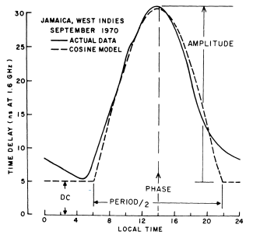
Klobuchar Model²
Models the diurnal effects of ionospheric delay
Parameters are part of the broadcast message
Uses eight parameters updated daily to model global ionosphere, so it is not very accurate.
Useful for single-frequency receivers.

Slide 7
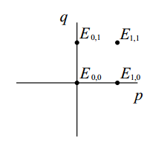
Global TEC Map
TEC maps are created using empirical data from many stations.
Distributed in IONEX files.
TEC is given at latitude/longitude points, forming a grid at different epochs
Bivariate interpolation can be used to find TEC between IONEX latitudes and longitudes³:
TEC between epochs was linearly interpolated for this analysis.

Slide 8
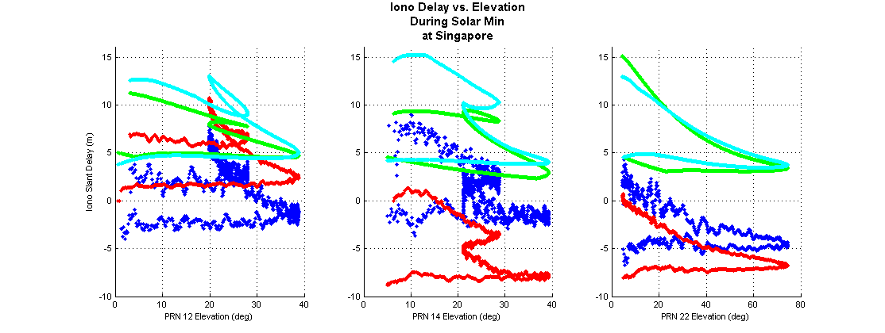
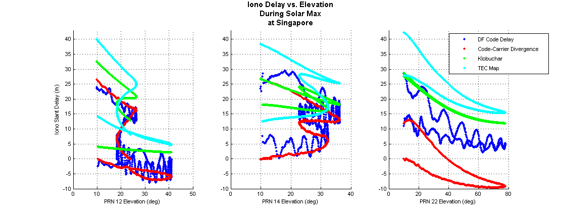
Results: Singapore I_{slant} vs. Elevation
Notes:
The DF-code and code-carrier divergence data trends look really close to that of the interpolated TEC map. There is a bias, however. The IONEX file listed a bias for NTUS of 15.2m.
Solar min data is noiser than solar max data. There was a firmware updated for the receiver mentioned in the logs. There may have been a harware/cabling update as well.
Wavy motion of the code is probably due to multipath. There are lots of buildings that can be seen in the pictures of the receiver.

Slide 9
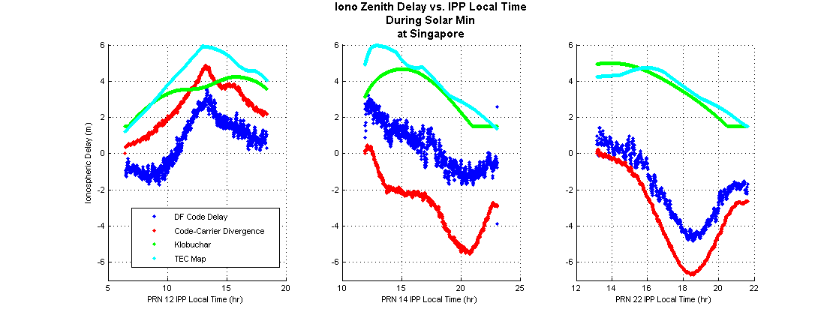
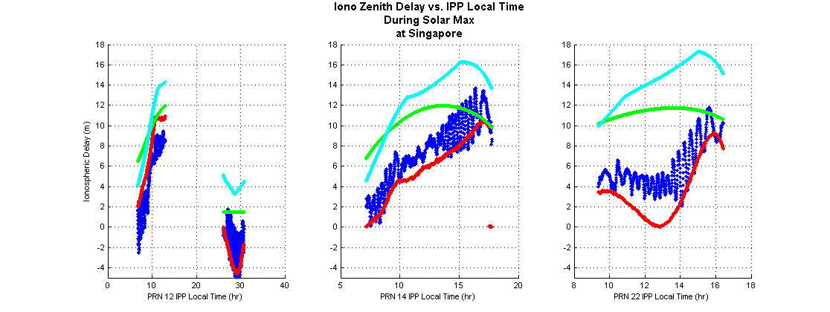
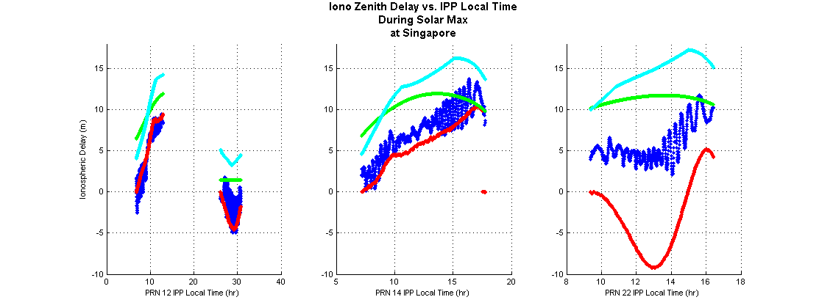
Results: Singapore I_{zenith} vs. t_{local}
Notes:
Again, the data trends match up pretty well, except PRN 22 during solar max. Hypothesis for this is that the multipath might be bad enough that the carrier measurement is inaccurate (despite having a lock on the signal?).
The slopes are also more pronounced for C-C Divergence. This is due to the division of the obliquity factor from the slant delay.

Slide 10
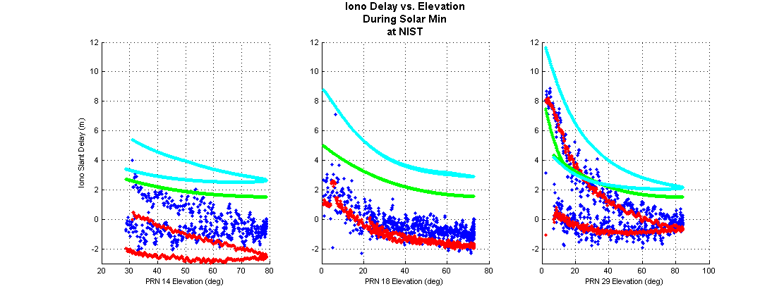
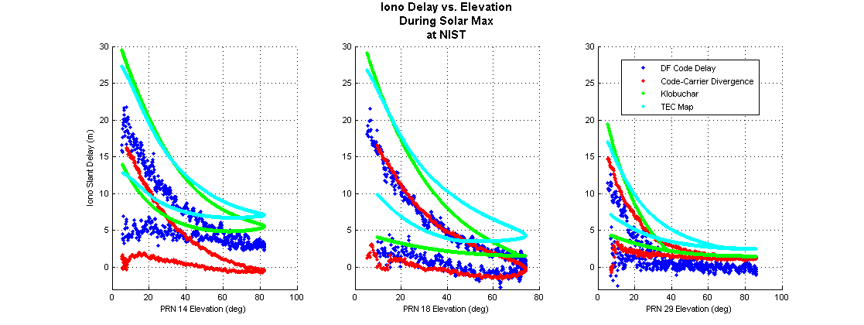
Results: NIST I_{slant} vs. Elevation
Notes:
Data trends again match. Klobuchar stays at night-time value for these latitudes (see backup slides) during solar min. Solar max shows higher delay magnitudes.

Slide 11
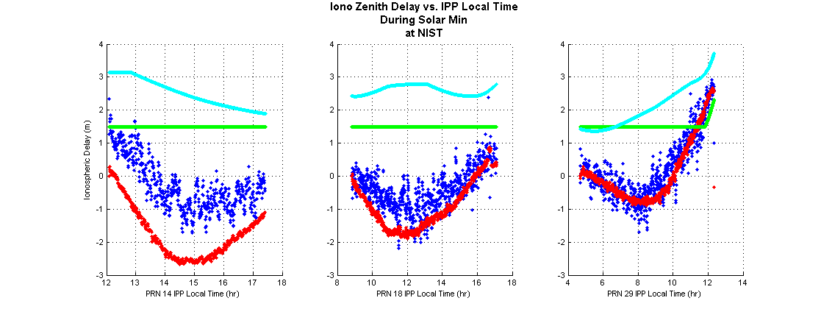
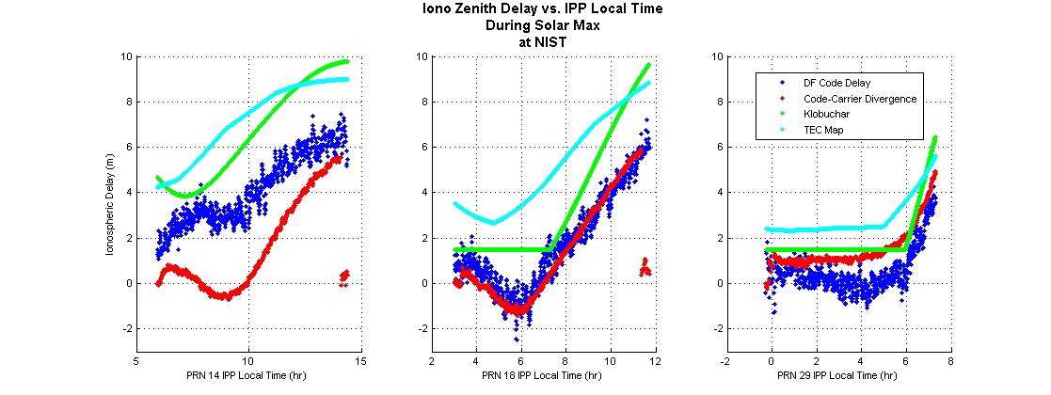
Results: NIST I_{zenith} vs. t_{local}
Notes:
Data trends are again pretty close. The TEC map local mins/maxes are in different local times than the measured/Klobuchar data. This is because the TEC map epochs are 2 hours apart, and the solar max has a lot more activity in the ionosphere (more drastic changes).

Slide 12
Conclusions
Interpolating TEC map between two-hour intervals makes it difficult to see when exactly TEC increases/decreases considerably.
Klobuchar, with 8 parameters applied globally, tends to underestimate the delay at contiguous-US latitudes
The dual-freq. code measurements are very noisy.
Code-carrier divergence have different slopes than the code-measured delay. Partially due to the biasing of the data discussed in Methods. If the ambiguity could be solved for, it would probably line up better.
Code-carrier divergence can be an accurate single-frequency solution if the ambiguity can be resolved.
Proper modelling of other errors could allow for smooth, accurate delay estimation.
As expected, equatorial delay was much greater than that at mid latitudes (using TEC map as truth).

Slide 13
Bibliography
¹Misra, P, and Enge, P., Global Positioning System: Signals, Measurements, and Performance, 2nd ed., Ganga-Jumana Press, 2012.
²Klobuchar, J., “Ionospheric Time-Delay Algorithm for Single- Frequency GPS Users”, IEEE Transactions on Aerospace and Electronic Systems, Vol. AES-23, No. 3, May 1987, pp 325- 331.
³Schaer, S., Gurtner, W., and Feltens, J., “IONEX: The IONosphere Map Exchange Format Version 1”, Proceedings of the IGS AC Workshop, Darmstadt, Germany, Feb 9-11, 1998, URL: ftp://igscb.jpl.nasa.gov/pub/data/format/ionex1.pdf [cited 4 Nov. 2014].

Slide 14
Backup

Slide 15
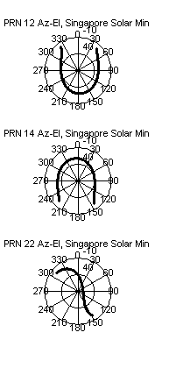

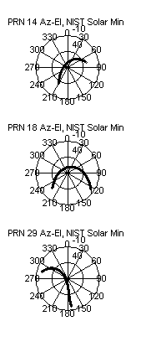
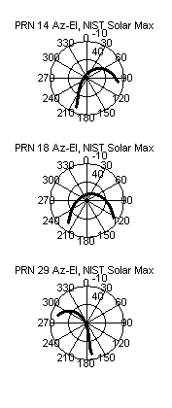
Az/El plots for selected PRNs

Slide 16
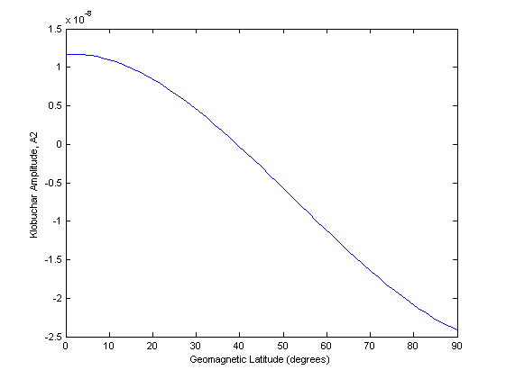
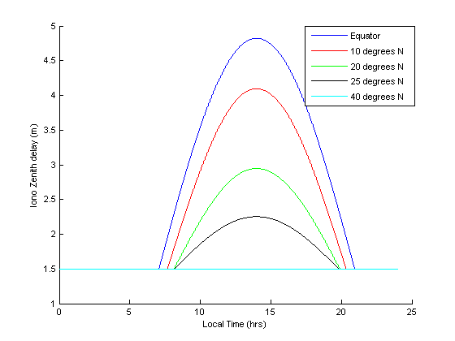
Klobuchar at high latitudes
Klobuchar assumes user is between latitudes of -75° to 75°
Plots show parameters on 2009-03-20, 105°W longitude
Notes:
Higher geomagnetic latitudes make Klobuchar break down, causing the amplitude to be below the nighttime value!

Slide 17
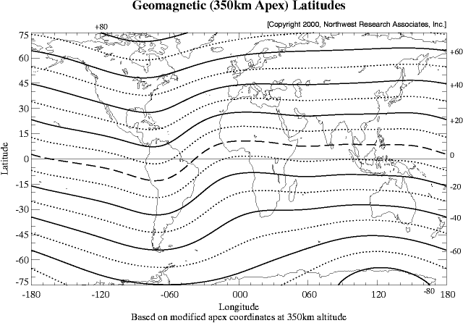
Magnetic Latitude
http://www.nwra.com/ionoscint/maps/maplats.gif
Notes:
North America is pretty high in geomagnetic latitude.

Slide 18
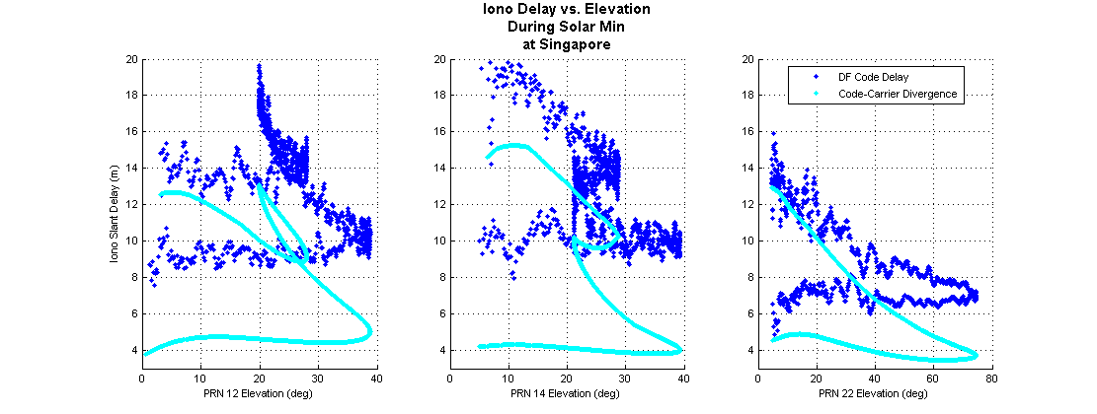
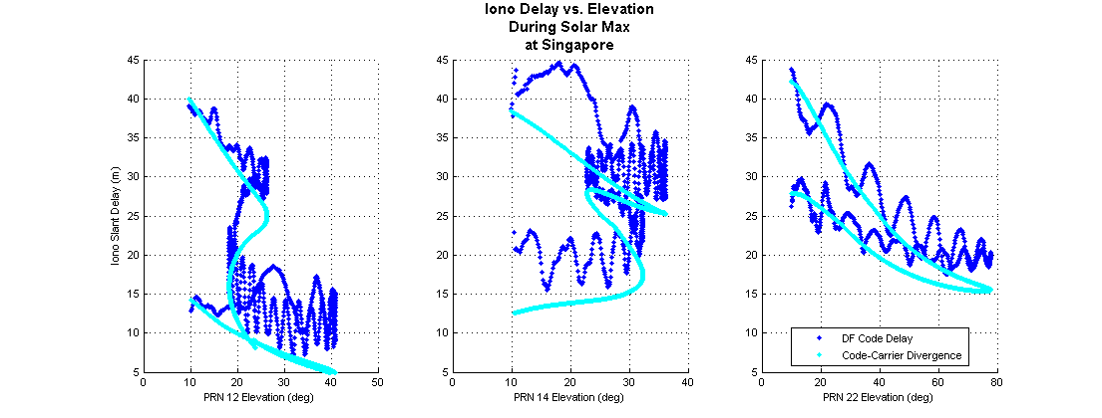
Attempt to resolve DF Code bias
Notes:
These made use of the bias presented in the IONEX file. Solar min doesn’t look right. Solar max is closer. If this is the right way to account for bias, the TEC map’s interpolation might be the cause of error between the two.

